Slide 1





HYPERMARKET SALES ANALYSIS
presented by : Ibrahim Abdelftah
@iabdelfta@gmail.com

Slide 2

1
INTRODUCTION
Hello everyone, today we will present an analysis of our sales data to support better decision-making and boost performance. We'll focus on the key findings that stood out, including trends in sales, customer behavior, and payment methods. At the end, we’ll highlight the most important decisions we recommend based on these insights.
Let’s dive into the data.

Slide 3

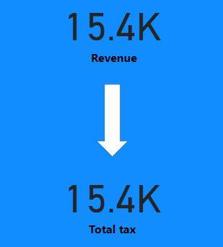
IMPACT OF GLOBAL MARKETS ON LOCAL LABOR
Preliminary Conclusions:
Net profit margin is zero: Revenue equals total tax, leaving no profit after covering purchase costs and taxes.
Tax is the only revenue source: The company relies solely on tax as revenue, as purchase cost matches the selling price.
Challenges:
No profit margin: This is unsustainable long-term as the company can't cover operational costs like salaries, rent, and marketing.
Dependency on tax: Relying on tax makes the company vulnerable to policy changes.
2

Slide 4
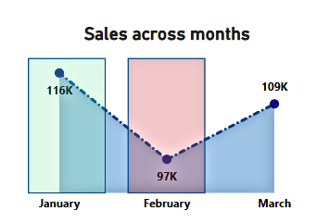

GLOBAL MARKET DEFINITION
3
Sales rise in January: Sales hit a record 116,000 units, likely due to the holiday season or strong early-year marketing.
Sharp decline in February: Sales dropped to 97,000 units, possibly due to seasonal changes, weak demand, or economic factors.
Slight increase in March: Sales recovered slightly to 109,000 units, suggesting a potential rebound in demand or the start of a new season.

Slide 5

5
RECOMMENDATIONS
Increase investment in marketing and promotions for high-sales departments to further boost revenue.
Analyze and improve the performance of low-sales departments by adjusting product options, marketing strategies, or customer service.
Ensure product prices are higher than purchase costs to generate profit, as the current profit mainly comes from taxes on customers.
Address the sharp sales decline in February by introducing targeted advertising campaigns, as January saw the highest sales in Q1.
Launch promotions or discounts for low-performing sections like health and beauty to drive sales growth.

Slide 6

@re
THANK YOU
To everyone who is present here

